Slide 1
Purchasing and Supply Management Organization
Chapter 5

Slide 2
Chapter Overview
Purchasing and supply management organizational structure
Location of authority – centralized vs. decentralized
Purchasing’s position within the organizational structure
Scope of purchasing/supply management job function

Slide 3
Chapter Overview
Purchasing/supply management job tasks
Separating strategic and operational purchasing
Using teams as part of organizational structure
Supply chain management structure
Future trends in organizational design

Slide 4
P/SM Organizational Structure:
Influences and Direction
Trends Driving P/SM Structure |  | Strategies and Objectives |  | Organizational Design
Cost containment Risk management Globalization Technology Collaboration Customer intimacy Increased P/SM responsibilities Increased P/SM skills Mobile devices |  | Support organization strategies Manage cost/price Supplier relationships Supplier integration Supplier innovation Manage global supply base |  | Centralized/Center-led Decentralized
 |  |  |  | Organizational Enablers
 |  |  |  | Business unit leaders Global buying groups Strategic sourcing groups Lead division buying Consortiums & GPOs e-sourcing/ERP suites
 |  |  |  | Business Unit Enablers
 |  |  |  | CFTs e-sourcing/ERP suites

Slide 5
Organizational Structure
Location of formal power for purchasing decisions
Division of purchasing tasks and activities
Scope of jobs in supply management function

Slide 6
Organizational Structure
Patterns of communication and workflow
Relative job satisfaction of P/SM employees
Overall effectiveness of P/SM in meeting its goals and objectives

Slide 7
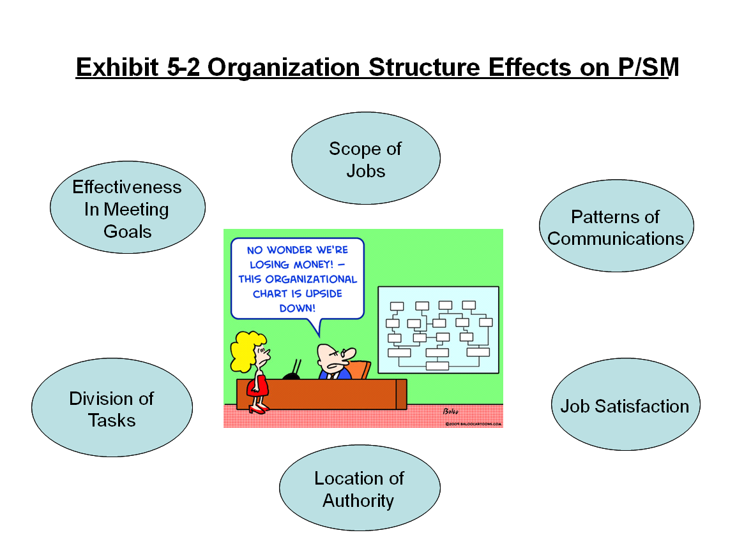
Organization Structure Effects on P/SM

Slide 8
Centralization vs. Decentralization
Centralized
  Chief purchasing officer has authority for majority of purchase expenditures
Center-led
  Centralized approach for common items and decentralized approach for unique ones
Decentralized
  Divisional, business unit, or site levels have authority for majority of purchase expenditures

Slide 9
Drivers of Organization Structure
Firm’s overall business strategy
  Responsiveness → decentralized
  Efficiency → centralized
Similarity of purchases
  Similar → centralized
  Dissimilar → decentralized

Slide 10
Drivers of Organization Structure
Total purchase dollar expenditures
  Small → decentralized
  Large → centralized
  Emerging role of e-sourcing software
Overall philosophy of management
  Highly controlled → centralized
  Less control → decentralized

Slide 11
Advantages of Centralization
Leverage purchase volumes
Reduced duplication of purchasing effort
Coordination of purchasing strategies and plans

Slide 12
Advantages of Centralization
Coordination and management of company-wide purchasing systems
Development of specialized expertise
Meet corporate goals and manage company-wide change

Slide 13
Advantages of Decentralization
Speed and responsiveness
Understanding unique operational requirements
New-product development support
Ownership of decisions affecting purchases

Slide 14
Organizational Mechanisms to Enable Center-Led Structure
Center-Led Enablers
Corporate Steering Committees
Regional Buying Groups
Business Unit Leaders
Strategic Sourcing Groups
Consortiums and GPOs
Lead Division Buying
Global Sourcing Councils
Corporate Purchasing Councils

Slide 15
Organizational Mechanisms to Enable Center-Led Structure
Strategic sourcing groups
  Often located by sourcing region
  Use of a common ERP system for spend management
Lead division buying
  Common items across divisions
  Largest using division takes lead in contracting for common items

Slide 16
Organizational Mechanisms to Enable Center-Led Structure
Business unit leaders
  Located at corporate level
  Interface with business unit CFTs
  Provide expertise and input
Global sourcing councils
  Worldwide commodity sourcing teams
  Global coordination for key commodities

Slide 17
Organizational Mechanisms to Enable Center-Led Structure
Regional buying groups
  Used when geographic concentration exists
  Responsible for large-volume common items
Corporate purchasing councils
  Similar items at various facilities
  Share expertise and develop common sourcing strategies

Slide 18
Organizational Mechanisms to Enable Center-Led Structure
Corporate steering committees
  Tend to be more advisory in nature than corporate purchasing councils
  Develop sourcing strategies
Consortiums and group purchasing organizations (GPOs)
  Spend category expertise and contract management skills
  Usually within single industry

Slide 19
Formal Organizational Structure
Details assignment of work along with authority that accomplishes those responsibilities
Helps define how firm communicates and integrates decision making across groups comprising organization, i.e., coordination

Slide 20
To Whom Does Purchasing/Supply Management Report?
Upper-level function reporting to executive vice president
Mid-level function reporting to executive one level below executive vice president
Lower-level function reporting at least two levels below executive vice president

Slide 21
P/SM as Upper-Level Function
President/CEO
Vice President Marketing
Executive Vice President
Vice President Finance
Vice President Purchasing
Vice President Engineering
Vice President Manufacturing

Slide 22
P/SM as Mid-Level Function
President/CEO
Vice President Marketing
Executive Vice President
Vice President Finance
Vice President Engineering
Vice President Manufacturing
Director of Purchasing

Slide 23
P/SM as Lower-Level Function
President/CEO
Vice President Marketing
Executive Vice President
Vice President Finance
Vice President Engineering
Vice President Operations
Director of Materials Management
Purchasing Manager

Slide 24
Factors Affecting P/SM’s Position in the Organization’s Hierarchy
History
Impact on organizational performance
Founder’s philosophy
Type of industry
Total spend on goods and services
Type of purchased materials and services

Slide 25
Scope of P/SM Job Function
Sourcing, negotiation, and contract management
Market intelligence and research
Operational support and follow-up
Administration and data management

Slide 26
Sourcing, Negotiation, and Contract Management
Identifying spend and matching to best potential suppliers
Negotiating with selected suppliers
Managing the contract

Slide 27
Market Intelligence and Research
Developing systematic monitoring of supply environment
  Assure continual economic supply of goods and services
Conducting value analysis programs
Assessing supplier capabilities
Analyzing supplier cost structures

Slide 28
Operational Support and Follow-Up
Supporting day-to-day operations including expediting
Preparation and transfer of material releases
Many tasks are now automated

Slide 29
Administration and Data Management
Developing policies and procedures
Administering and maintaining purchasing information systems and databases
Determining required staffing levels
Developing departmental plans
Organizing training and development
Developing measurement systems

Slide 30
P/SM Job Tasks
Buying
Expediting
Inventory control
Transportation
Insourcing/ outsourcing
Value analysis
Purchasing research/Materials forecasting
Supply management
Other responsibilities

Slide 31
Other Departmental Activities
Receiving and warehousing
Managing travel arrangements
Production planning and control
Commodity futures trading
Global transportation and materials management
Economic forecasting
Subcontracting

Slide 32
Sourcing Activities
Strategic | Manage relationships with critical suppliers Develop electronic purchasing systems Collect and manage market intelligence data Negotiate companywide supply contracts Manage critical commodities Manage risk monitoring programs
Operational | Manage transactions with suppliers Use e-systems to obtain standard or indirect items through catalogs Source items that are unique to operating unit Generate and forward material releases and expedite Provide supplier performance feedback

Slide 33
Use of Supply Management Teams
Evaluate and select suppliers
Develop global commodity strategies
Perform demand and supply planning
Carry out supplier development activities

Slide 34
Benefits from Using Teams
Synergies gained from a wider range of knowledge through collaboration
Better decision making
Creation of a more involved workforce
Facilitation of improved products and services

Slide 35
Drawbacks from Using Teams
Waste time and energy of members
Enforce lower performance norms
Create destructive conflict within and between teams
Make notoriously bad decisions
Exploit, stress, and frustrate members

Slide 36
Hurdles Involved with Teams
Part-time vs. full-time members
Failure to recognize and reward effort
Individualistic U.S. national culture

Slide 37
Work Team Planning Guide
Identify appropriate team assignments
  Do assignments justify use of teams?
  Has proper team model been identified?
    Part-time vs. full-time
  Does executive and functional management support use of a team?

Slide 38
Work Team Planning Guide
Form work team and select qualified members and leader
  Have core vs. as-needed members been identified?
  Do members have proper skills, time, and commitment to support the team?
  Have team sponsors identified and selected a qualified team leader?

Slide 39
Work Team Planning Guide
Form work team and select qualified members and leader (cont.)
  Are customers or suppliers part of team if required?
  Do members understand their formal team roles?

Slide 40
Work Team Planning Guide
Determine member training requirements
  Have team member training requirements been assessed?
  Is required training available on a timely basis?
Identify resource requirements
  Are resources provided or available to support team’s task?

Slide 41
Work Team Planning Guide
Determine team authority levels
  Have team authority levels been determined?
  Have team authority levels been communicated across the organization?
Establish team performance goals
  Has the team established objective performance goals?

Slide 42
Work Team Planning Guide
Determine how to measure and reward participation and performance
  Are approaches and systems in place that assess team performance and member contribution?
  Are there reporting linkages to team or executive sponsors?
  Is team performance effectively linked in performance reward systems?

Slide 43
Work Team Planning Guide
Develop team charters
  Has a formal charter been developed that details team mission, tasks, broad objectives, and so forth?
  Has the charter been communicated across the organization?

Slide 44
An SCM Structure Example
President/CEO
Vice President of SCM
Director of Strategic Sourcing
Director of Production Planning
Director of Logistics
Director of Operations
Director of Customer Service
Director of Materials
Receiving and Storage Manager
Inventory Control Manager
Inbound Transportation Manager

Slide 45
Future Trends in
Organizational Design
Vertical focus → horizontal focus
  No functional silos
Commodity focus → process focus
  Cut across functional boundaries
Flatter hierarchies
Center-led structures
Rotation of management across business units and functional groups

Slide 46
Future Trends in
Organizational Design
Co-location with internal customers
Systems capability
  Flow of goods information and processes from suppliers to final customers
Open information channels
Virtual social networking

Slide 47
Horizontal Organization Example
Marketing
Engineering
Finance
Supply Mgt
Supplier evaluation and selection
New product development
Order generation, scheduling, and fulfillment
Integrated logistics

Slide 48
Future P/SM Organizations
Today
Vertical/Functional focus
Individual decisions
Tomorrow
Horizontal/Process focus
Closed information loops
Company leverage
Layered hierarchies
Functional location
Physical social networks
Team decisions
Open information flows
Group leverage
Flatter hierarchies
Co-location
Virtual social networks

